Slide 1


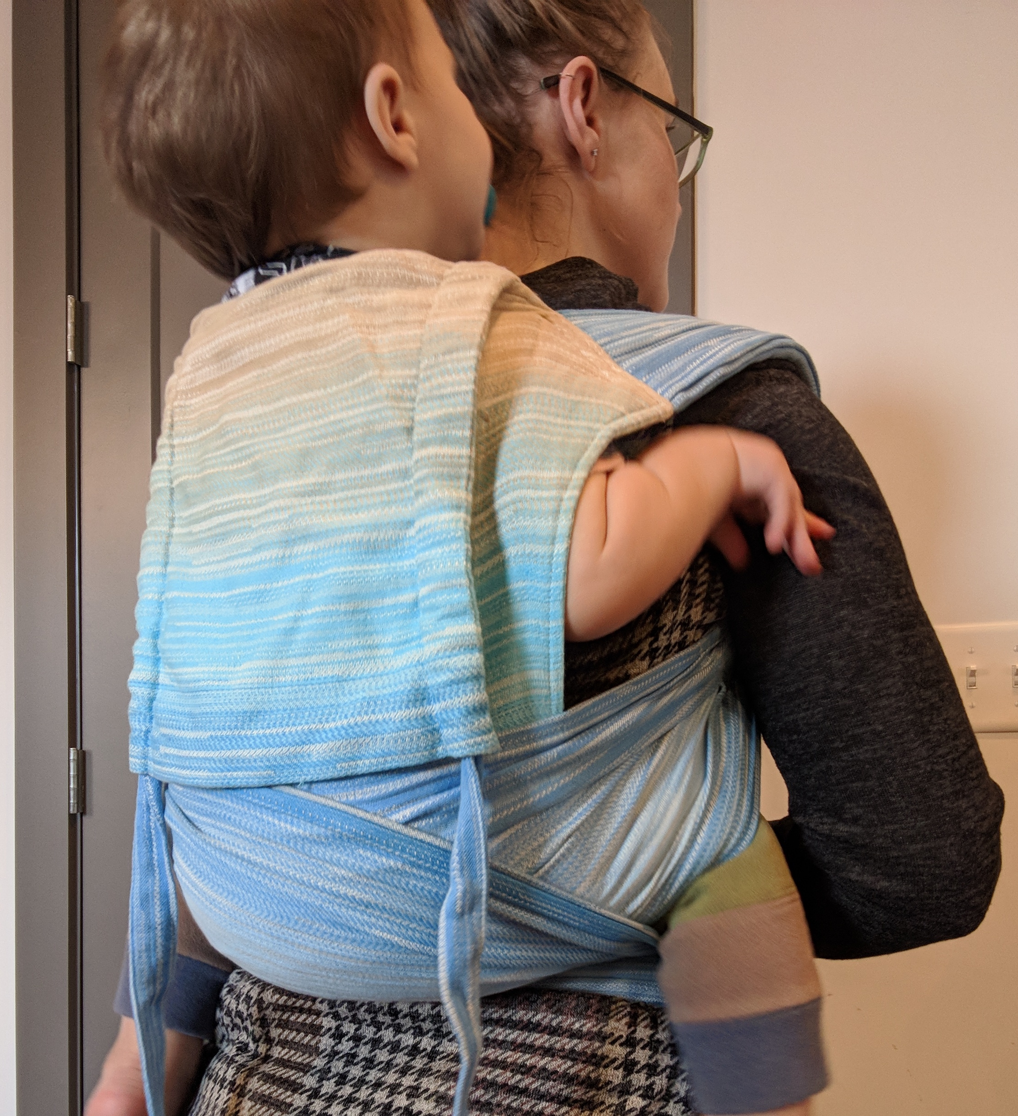
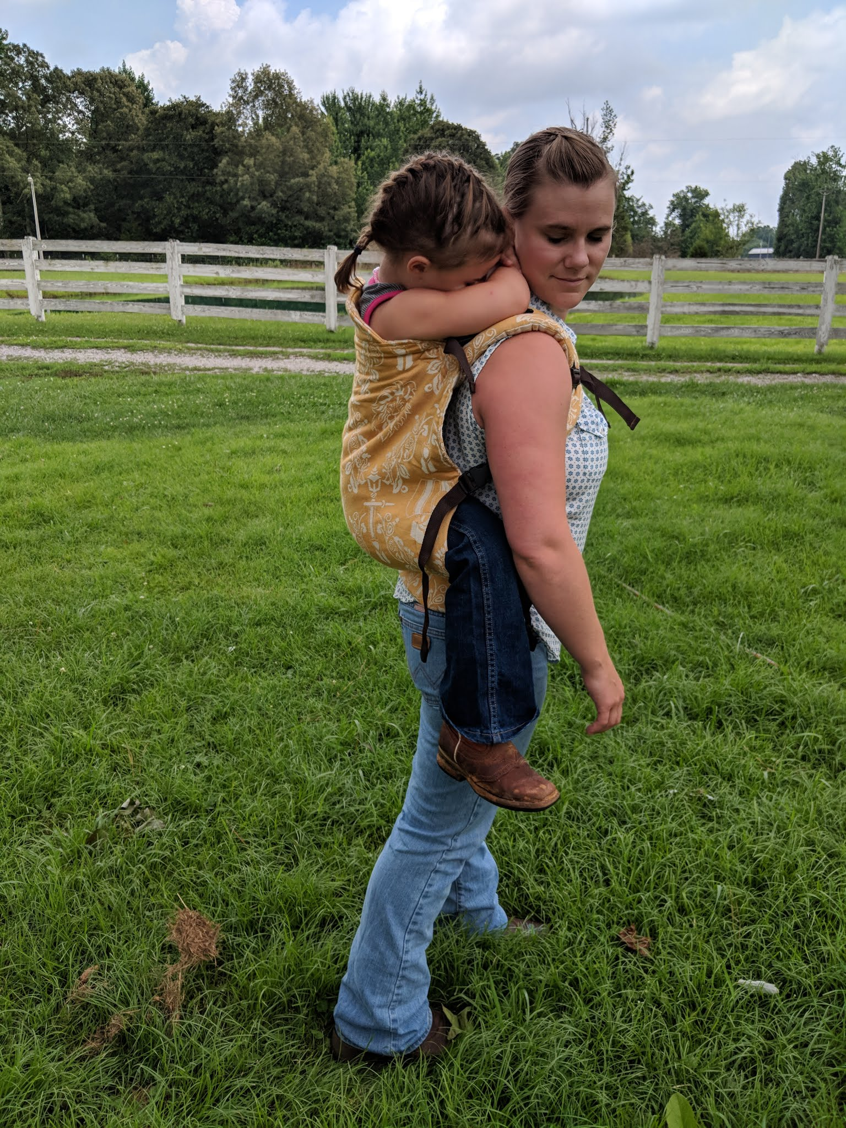
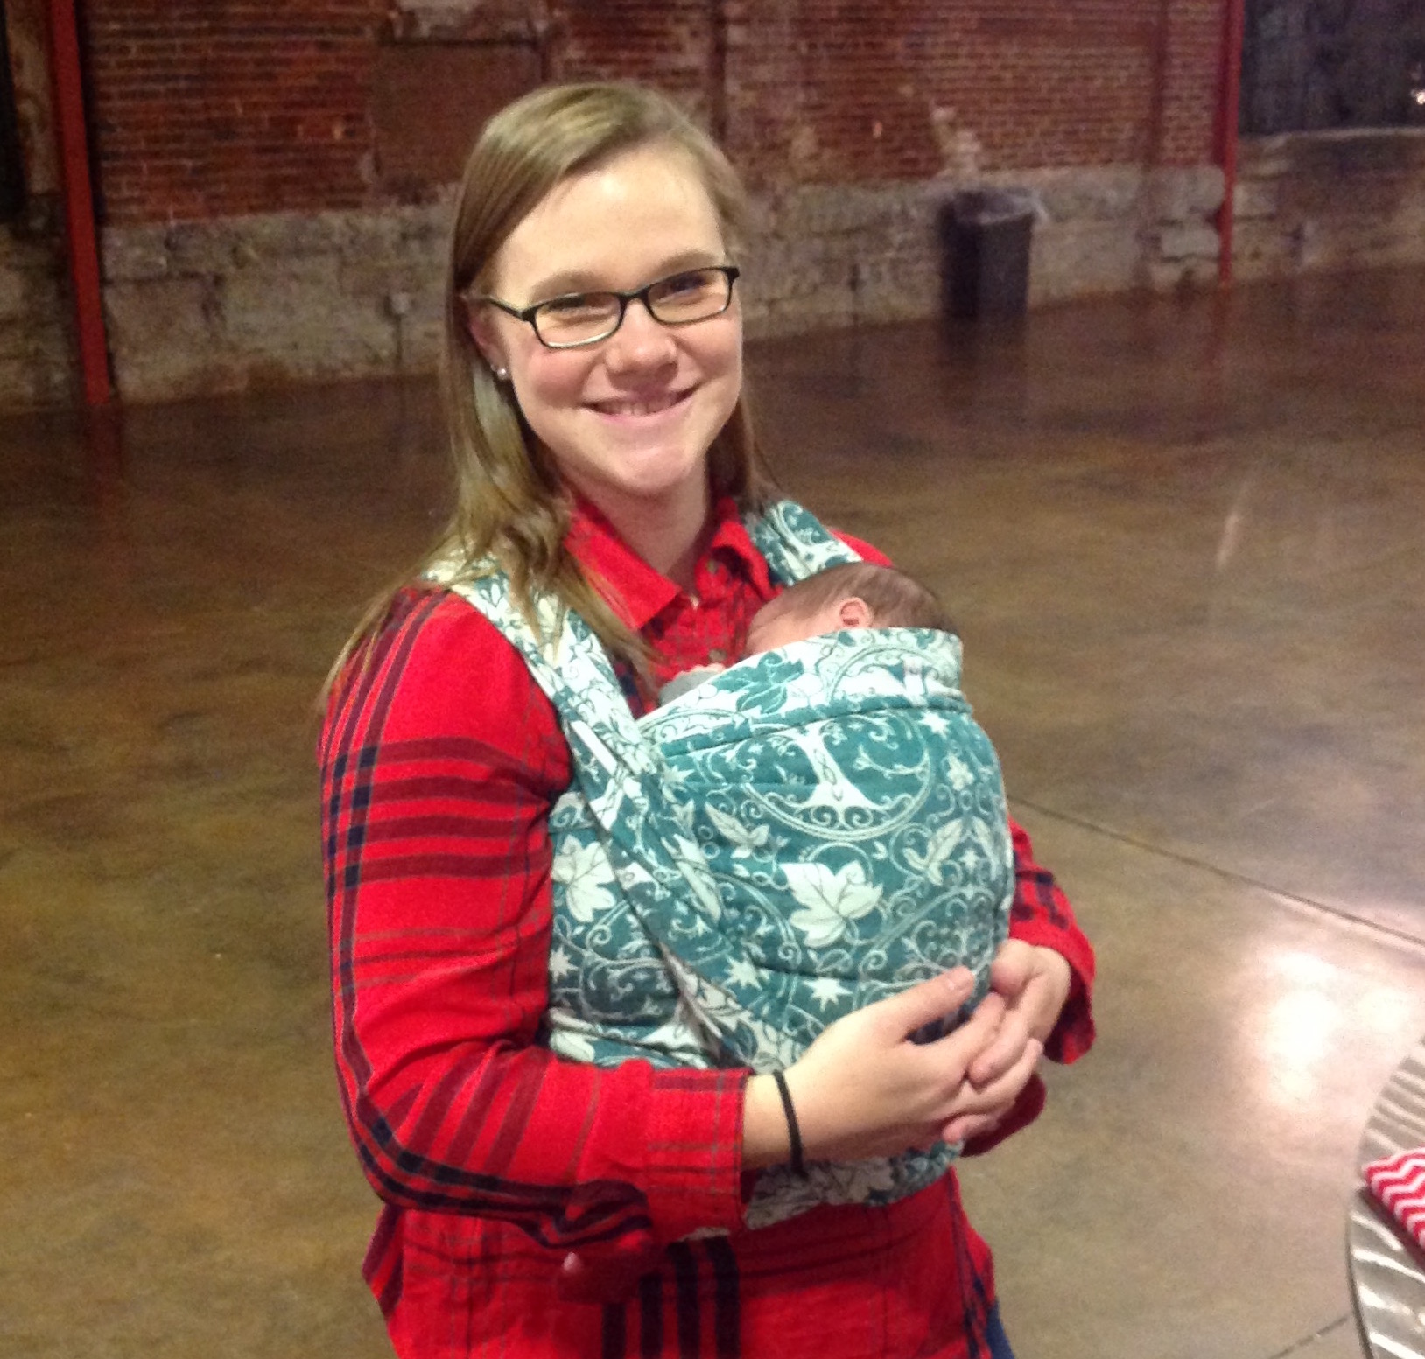
Creating the Pilot Survey:
The Physical and Mental Health Effects of Babywearing for Caregivers
Libby Day, Caleb Holdener, and Catherine Starnes, Ph.D.
Belmont University, Nashville, TN
Abstract
Participants
Sample Questions
Demographics:
Marital status
Number of children in household
Babywearing experience:
How frequently do your currently babywear?
Why do you use a baby carrier?
Mental and Physical Health
Please rate your confidence in your ability to detect and satisfy your child's needs.
Please rate your physical health in relation to your desired quality of life.
Overall Benefits and Challenges
What do you perceive as the overall advantages of babywearing?
What do you perceive as the overall disadvantages of babywearing?
Babywearing is the practice of using a baby carrier to carry and hold a child. Babywearing is a practical way for caregivers to keep infants close while still maintaining full mobility of both hands. This study aimed to develop a pilot survey examining the caregiver benefits of babywearing. Research specifically examining baby carriers is currently lacking, however the current research supports our hypothesis that babywearing is beneficial, both mentally and physically for the caregiver. Researchers have found that skin to skin contact increases parental sense of competence, sensitivity and infant responsiveness while also decreasing feelings of stress or worry (Charpak et al., 1997). This poster serves to summarize the development of a pilot survey of caregiver benefits in practicing babywearing. The next step is to deploy and validate the study.
In order to develop better questions for our survey, we conducted qualitative interviews. A total of 10 participants, 2 men, 8 women, participated in this study. They were volunteer participants recruited from one of three monthly meetings of Babywearing International. Each participant verified their caregiving role to a child under the age of 5. The Majority of the caregivers were biological parents, with one biological grandparent.
A survey was developed which included:
Voluntary interviews were conducted at three BWI meetings by student researchers to:
Iteratively, responses from each meeting were used to improve the survey.
Validate survey questions and pilot survey in the Middle Tennessee area.
Use validated survey to begin larger survey project intended to provide a better base to begin generating more specific hypotheses.
demographic questions about the caregiver
selected demographic questions about children in the caregiver’s care
babywearing experience and motivation
perceived benefits and challenges
perceived effects on the caregiver’s mental and physical health
improve survey questions, improve offered answer choices
to determine whether questions needed to be added or removed from the survey
Adapted survey for online deployment through Qualtrics.
added validates scales for Depression, Anxiety, and Stress
Procedure
Background
Research on Babywearing is lacking. The majority of research is invested in Kangaroo Care, which care emphasis skin to skin contact.
Babywearing has been found to provide a plethora of benefits such as
Regulate infant's sleep patterns
Decrease crying
Decrease child abuse
Increase breastfeeding length
Skin to skin contact has been found to increase bonding and attachment while also decreasing physiological symptoms of stress such as blood pressure (Jones & Santamaria, 2017).
Oxytocin, a hormone that is released during skin to skin contact, sex, childbirth, and breastfeeding, has been found to play a key role in parental behavior across mammalian species (Feldman et al., 2010).
Increases trust and prosocial behavior; decreases stress and anxiety.
Oxytocin is associated with affectionate touch and gaze in mothers and arousal and stimulation in fathers.
Works by downregulating the pathways that cause behavior of newborn directed aggression and feelings of avoidance, while also upregulating pathways that attract to infant stimuli.
Constant feedback loop: exposure to infant touch increases oxytocin production, which in turn increases parental behavior.
Significant rise in oxytocin in the first 6 months of infants life.
Postpartum depression has been found to hinder a mother's ability to detect and satisfy her child's cues. Skin to skin contact has been found to decrease depressive symptoms (Bigelow et al., 2012).
Caretaker stress might influence wheeze in infants with Cerebral Palsy through stress-induced behavioral changes in caregivers (e.g., smoking, breast-feeding) or biologic processes impacting infant development (e.g., immune response, susceptibility to lower respiratory infections) (Wright et al., 2001).
Less caregiving demands were associated with better physical and psychological well-being of caregivers, respectively. Similarly, higher reported family functioning was associated with better psychological health and physical health (Rauba, O’Donnell, et al., 2005).
Future Direction
Our next steps are to refine all the questions and answer choices, validate our survey, and deploy the survey on a larger scale.
Survey finalization
Pilot survey in middle Tennessee
Survey validation
Deploy survey on a larger scale
Begin larger survey project to provide a better base understanding of the effects of babywearing on caregivers and to develop more specific hypotheses on the effects of babywearing on caregivers
References
Charpak N, Ruiz-Pelaez JG, Figueroa Z, Charpak Y. Kangaroo mother versus traditional care for newborn infants </= 2000 grams: A randomized, controlled trial. Pediatrics. 1997;100(4):682–688.
Bigelow A, Power M, MacLellan-Peters J, Alex M, McDonald C. Effect of mother/infant skin-to-skin contact on postpartum depressive symptoms and maternal physiological stress.J Obstet Gynecol Neonatal Nurs, 41 (2012), pp. 369-382
Feldman, R., Gordon, I., Schneiderman, I., Weisman, O., Zagoory-Sharon, O. (2010). Natural variations in maternal and paternal care are associated with systematic changes in oxytocin following parent-infant contact.Psychoneuroendocrinology35 (8): 1133–1141.
Jones, H., & Santamaria, N. (2017). Physiological benefits to parents from undertaking skin‐to‐skin contact with their neonate, in a neonatal intensive special care unit. Scandinavian Journal Of Caring Sciences, doi:10.1111/scs.12543
Raina, P. O'Donnell, M., Rosenbaum. P., Brehaut, J., Walter, S., Russell, D., Swinton, M., Zhu, B., Wood, E. (2005). The Health and Well-Being of Caregivers of Children With Cerebral Palsy. Pediatrics,115(6). doi:10.1542/peds.2004-1689
Wright, R., Cohen, S., Carey, V., Weiss, S., & Gold, D. (2002). Parental Stress as a Predictor of Wheezing in Infancy. American Journal of Respiratory and Critical Care Medicine,165(3), 358-365. doi:10.1164/ajrccm.165.3.2102016
Center for Epidemiologic Studies Depression Scale Revised (CESD-R- 10)
Generalized Anxiety Disorder 7-item (GAD-7) scale
Percieved Stress Scale 4 (PSS-4)
Measures
Table 2
Fit Indices for the First Conceptual Model: Testing Maternal and Paternal Psychological
Symptoms as Mediators of the Association between Marital Distress and Child Adjustment
Table 3
Fit Indices for the Second Conceptual Model: Testing Marital Distress as a Mediator of the
Association between Parental Psychological Symptoms and Child Adjustment

